Slide 1


From Data Noise To IPO Narrative

Slide 2


Today's agenda
Project recap
Problem
Process
Insights
Summary

Slide 3

Social Buzz is a fast growing technology unicorn that need to adapt quickly to it’s global scale.
Accenture has begun a 3 month POC focusing on these tasks:
An audit of social Buzz’s big data pratice
Recommendation for a successful IPO
Analysis to find Social Buzz’s top 5 most popular categories of content
Project Recap

Slide 4


Problem
Over 100,000 posts per day 36,500,000 pieces of content per year!
But how to capitalize on it when there is so much?
Analysis to find social buzz’s top 5 most popular categories of content

Slide 5
Process
1
Stage 1: User behavior Analyst
Stage 2: Content based Analyst
2
3
Stage 3: Strategy and Next step

Slide 6
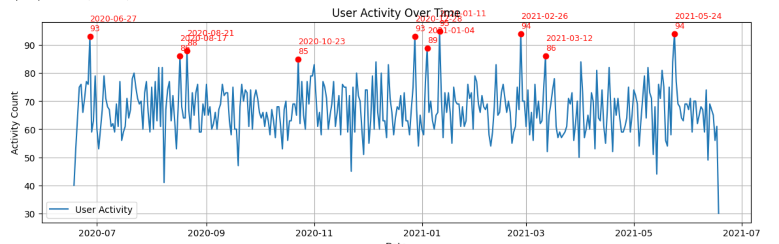
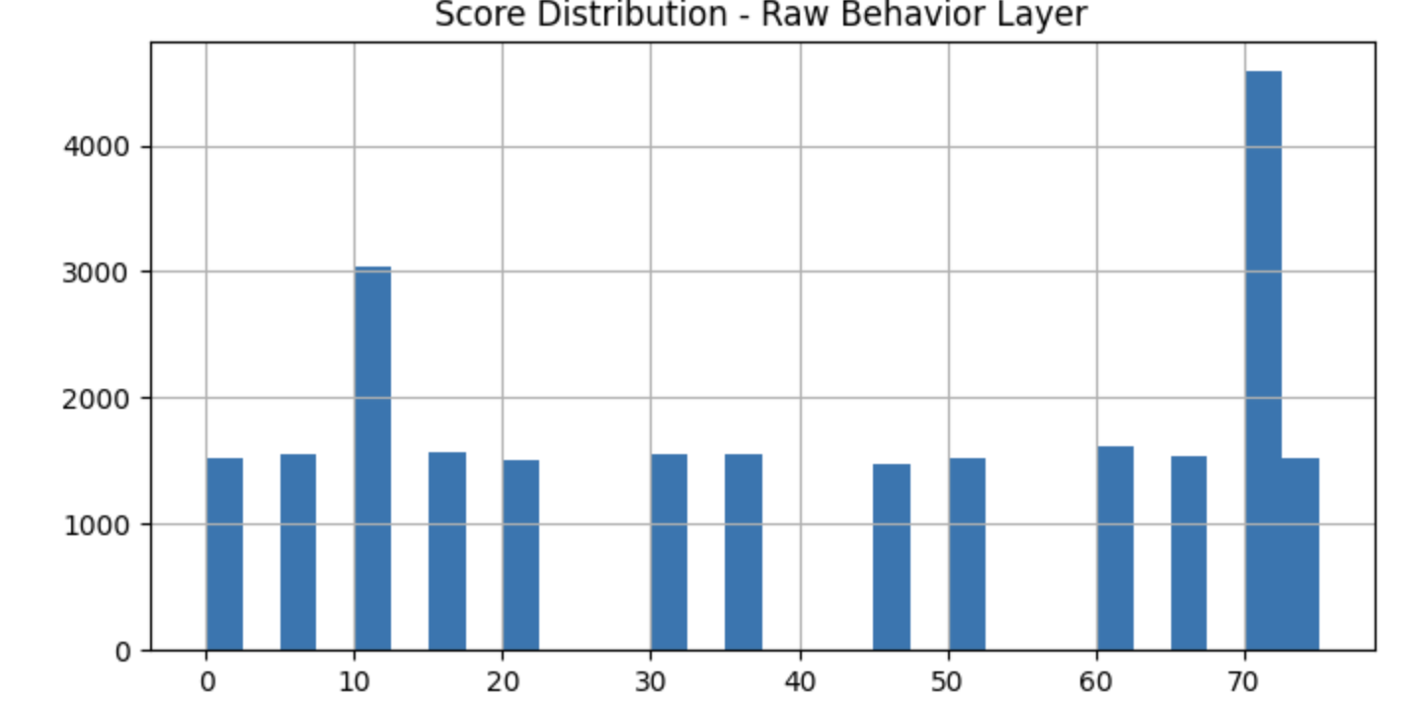
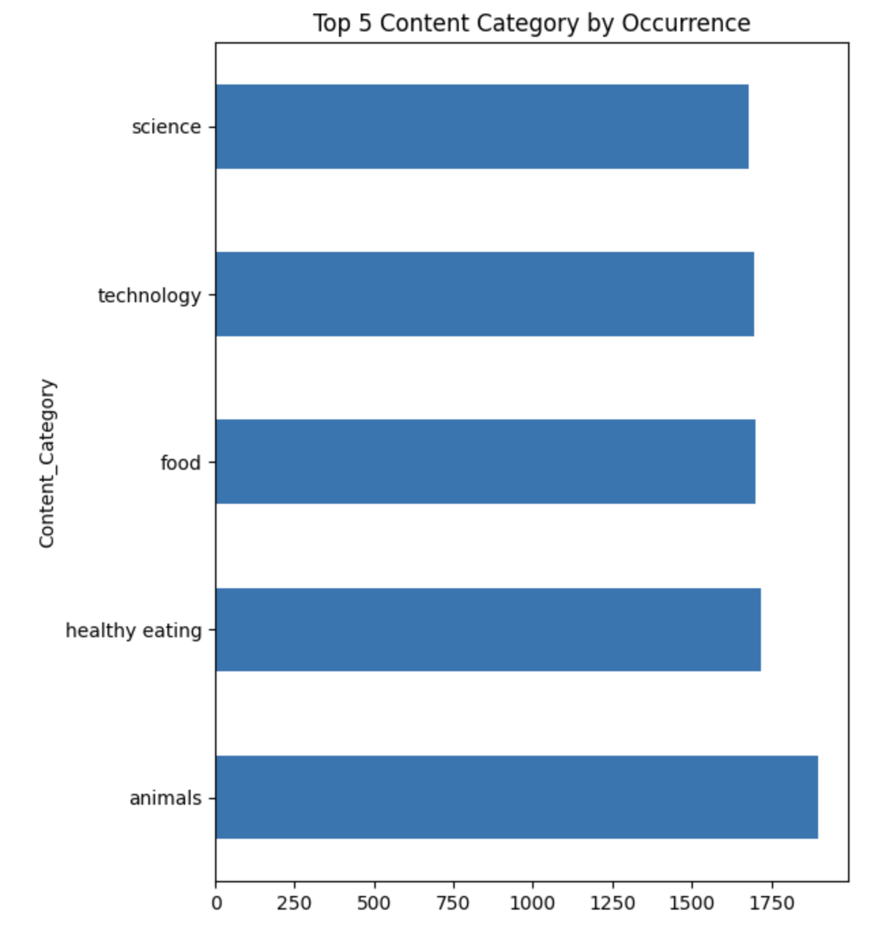
Top 5 preferred content
Stage 1: User behavior Analyst
Time Hotspot:
Scoring structure is skewed:
Content tag preference
Peak month is January and peak time is morning
the distorted mean is misleading
Peaks are concentrated in July, August, and December. and in the morning and evening.
The high score (70+) is abnormally concentrated, distorting the mean. 25.23% of the total sample above 70 account
The top five categories account for 21.37% of total content interactions, demonstrating a high keyword concentration.
Notes:
6200 / 24573 = 25.23%

Slide 7
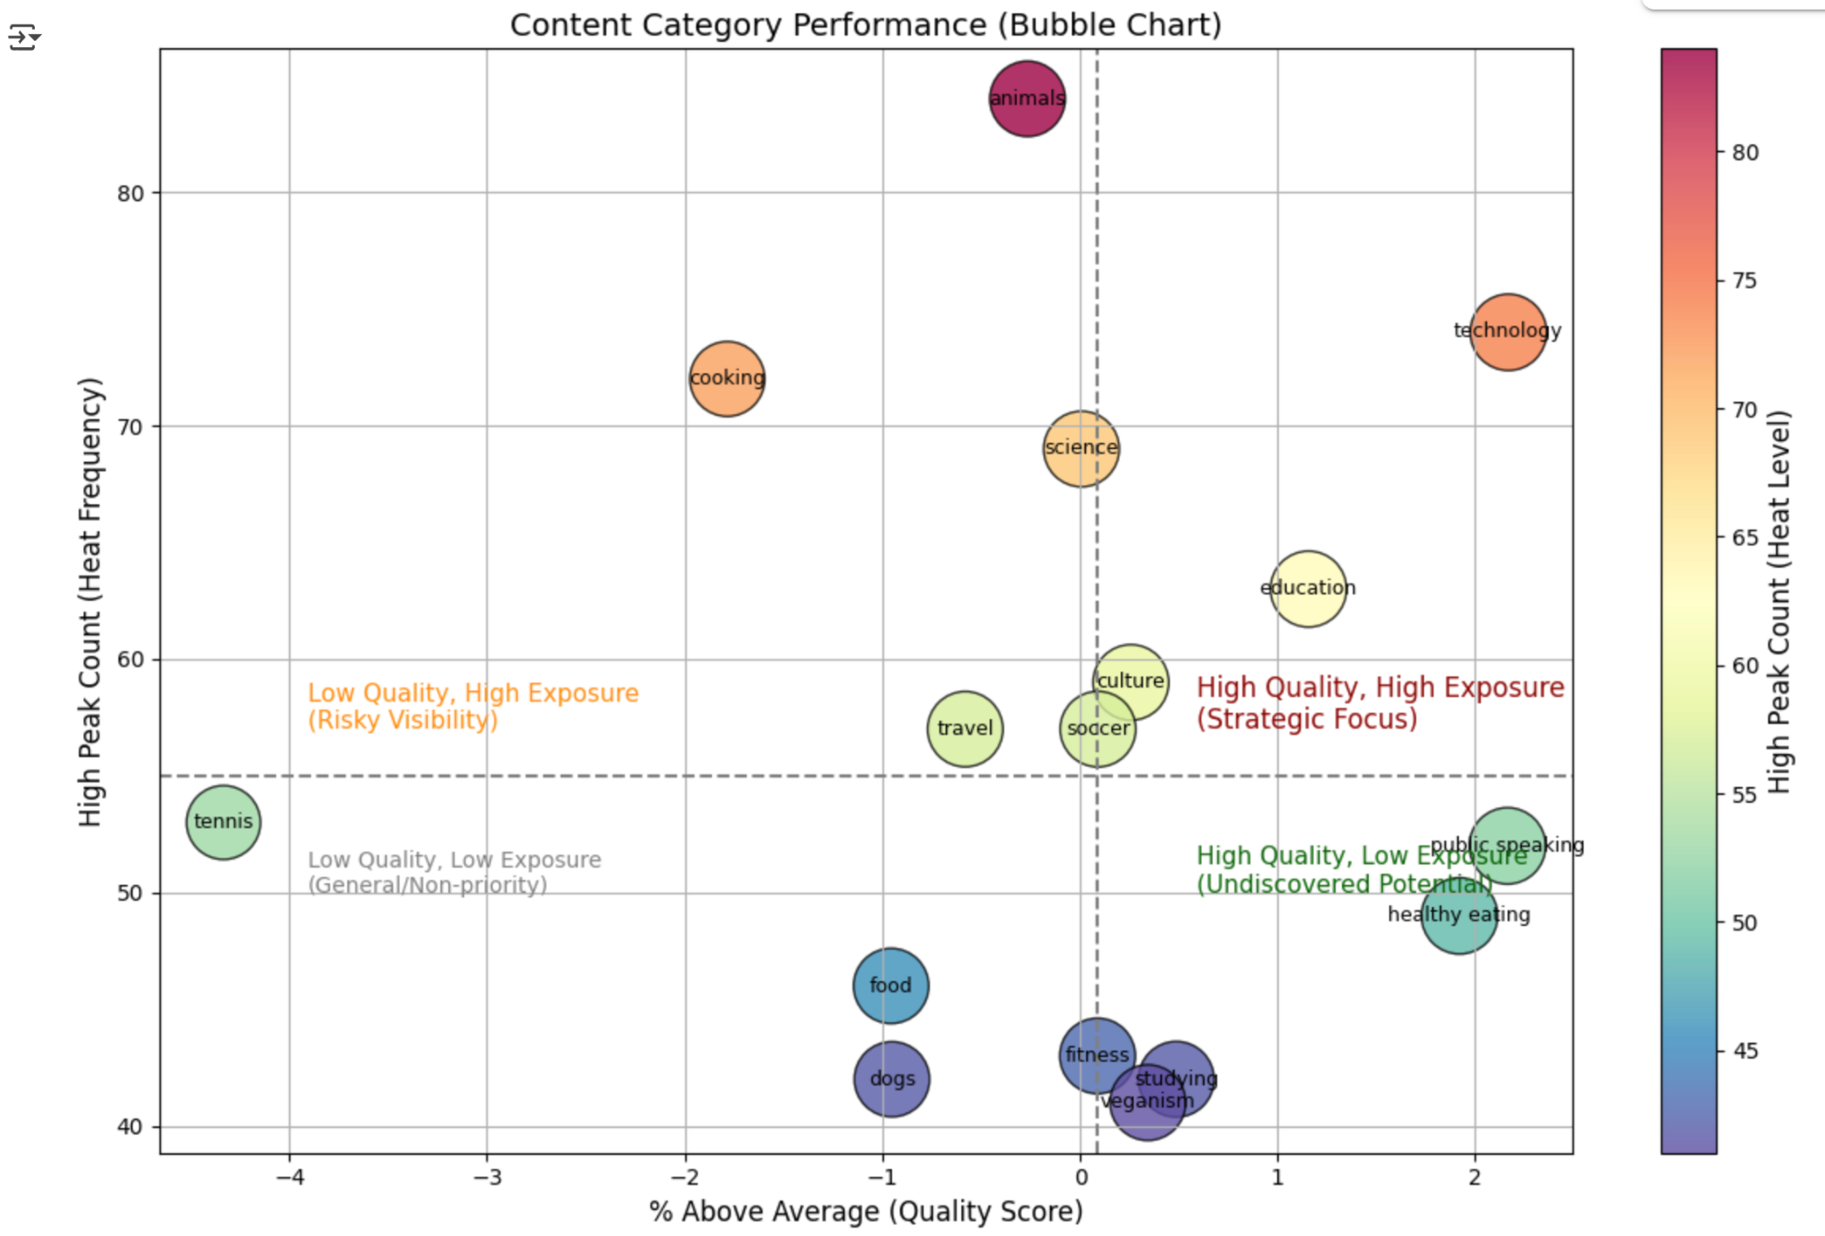
Stage 1: User behavior Analyst
Insights Summary:
While Technology and Education are top-performing with both high quality and visibility, Animals stands out as highly exposed yet low in quality. Some high-quality themes like Healthy Eating remain underexposed, indicating untapped potential.
Strategy Recommendation:
Focus on promoting high-quality but low-exposure topics to unlock growth (Hidden Gems), maintain momentum in Star Categories, and audit overexposed low-quality content to prevent engagement loss or algorithmic inefficiency.

Slide 8
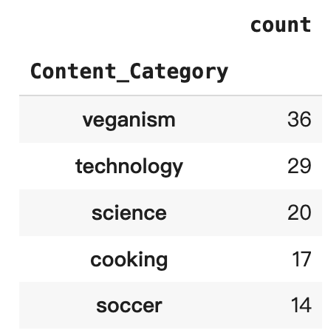
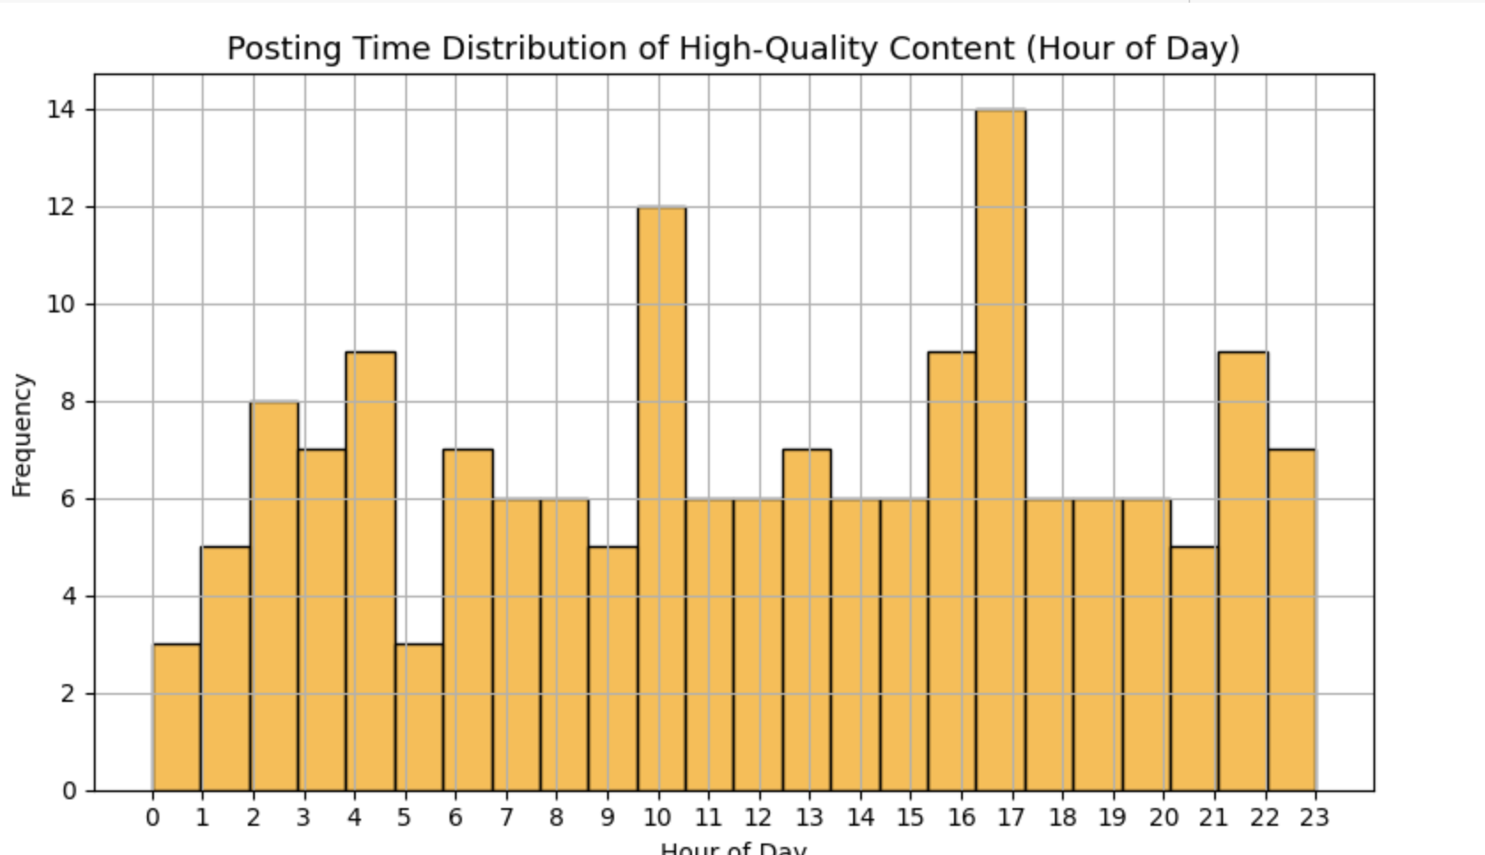
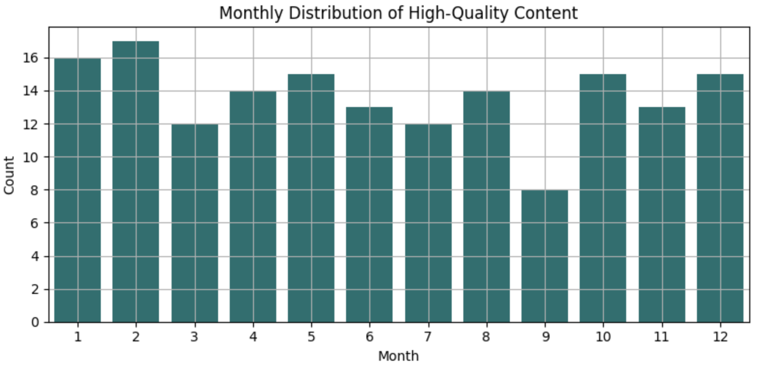
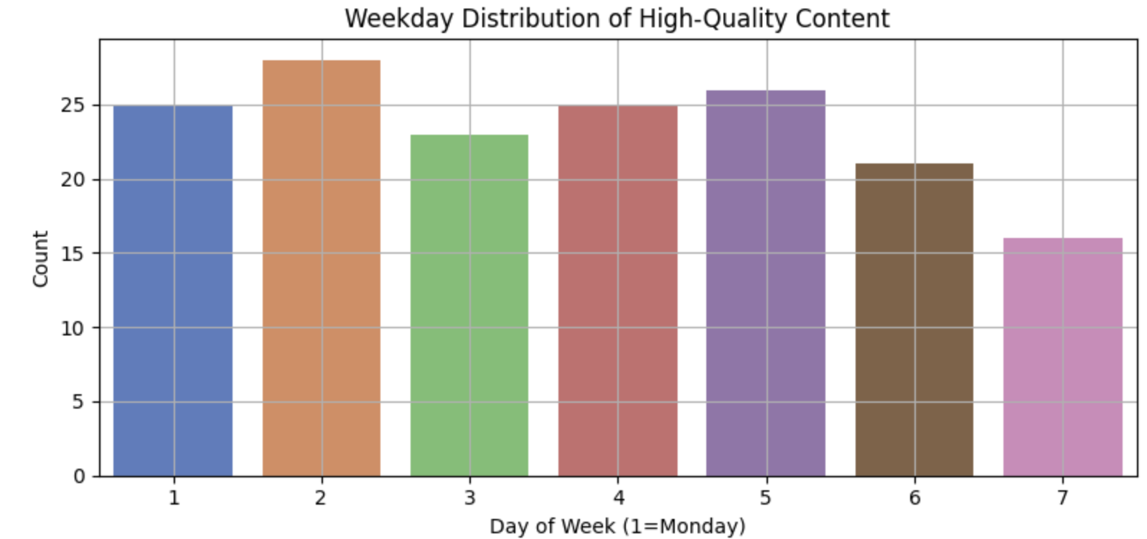
Top Content Categories: Stable High-Quality Themes
Time-of-Day Signal: Performance Peaks in Morning & Evening
Monthly Patterns: Q1 Sees a Surge in High-Quality Content
Weekday Signal: More High-Quality Content Appears on Monday–Tuesday
Stage 2: Content based Analyst
Category Focus → Time Strategy → Seasonal Rhythm → Weekly Timing
Most high-quality content concentrates in a few domains — Veganism, Technology, and Science — indicating consistent user interest and replicable themes.
Content with high scores is frequently posted around 6–7am，10-11am and 4–7pm, indicating optimal windows for release.
January and February show stronger output of top content, suggesting seasonal alignment or early-year engagement spikes
Top-performing content is more common at the start of the week, hinting that audiences may be more receptive during early weekdays.

Slide 9
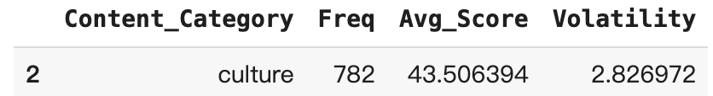
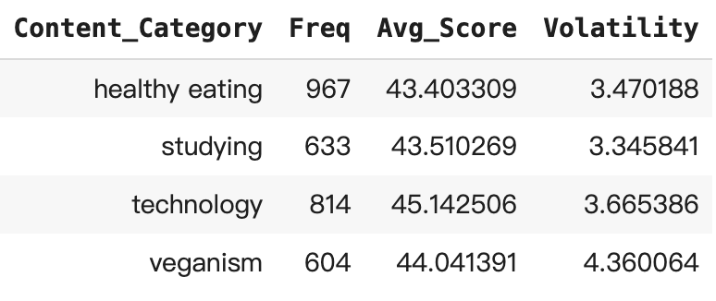
Stage 3: Strategy and Next step
Recommended Strategic Keyword
Risky Keywords (Not Advised for Replication)
The only category that meets all three dimensions: high frequency, high average score, and low volatility
If exploring new potential keywords, consider trialing median-volatility content (volatility < 3.5) with measured volume.

Slide 10


ANALYSIS
Culture is the only category with consistently high frequency, high quality, and low volatility—indicating stable and scalable engagement.
INSIGHT
Culture is a strong candidate for long-term content planning. In contrast, categories like healthy eating and technology show high engagement but greater volatility, signaling short-term viral potential.
NEXT STEPS
Prioritize Culture for stable scaling. Use volatility < 3.5 as a filter to test high-potential topics cautiously before wider rollout.
Summary

Slide 11

Thank you!
ANY QUESTIONS?

